Slide 1
Activation Functions
Deep Learning
By – Prashant Kumar, Kanak Ahuja

Slide 2
ACTIVATION FUNCTION
- Internal state of neuron.
- used to convert the Input signal on node of ANN to an Output signal.
- introduce non-linear properties to network.

Slide 3
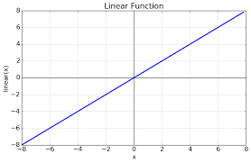
IDENTITY ACTIVATION FUNCTION
The linear activation function, also known as "no activation," or "identity function", is where the activation is proportional to the input. The function doesn't do anything to the weighted sum of the input, it simply spits out the value it was given.

Slide 4
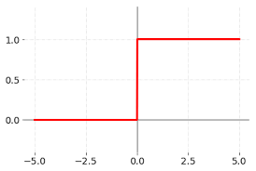
BINARY STEP ACTIVATION FUNCTION
The linear activation function, also known as "no activation," or "identity function", is where the activation is proportional to the input. The function doesn't do anything to the weighted sum of the input, it simply spits out the value it was given.

Slide 5
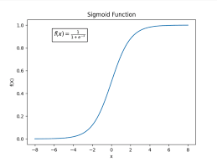
SIGMOD ACTIVATION FUNCTION
Sigmoidal function are frequently used in machine learning, specifically in the testing of artificial neutral networks, as a way of understanding the output of a node or “neuron”.
A sigmoid function is a type of activation function, and more specifically defined as a squashing function. Squashing functions limit the output to a range between 0 and 1.

Slide 6
Pros and Cons of Sigmoid Activation function
Pros
The performance of Binary Classification is very well as compare to other activation function.
Clear prediction, i.e very close to 1 or 0.
Cons
The calculation is sigmoid function is complex.
Its not useful in multiclass classification.
For negative values of x-axis gives 0.
Function output is not zero – centred.

Slide 7
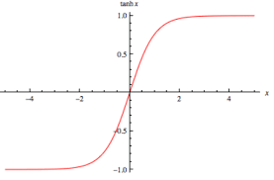
HYPERTANGENT ACTIVATION FUNCTION
The function is easily defined as the ratio between the hyperbolic sine and the cosine functions

Slide 8
Pros and Cons of Tanh Activation function
Pros
The gradient is stronger for tanh than sigmoid.
The output interval of tanh is 1 and the whole function is 0-centric, which is better than sigmoid.
Cons
1. Tanh also has the vanishing gradient problem.

Slide 9
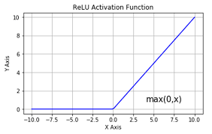
ReLu ACTIVATION FUNCTION
The ReLu function is actually a function that takes the maximum value.

Slide 10
Pros and Cons of ReLu Activation function
Pros
When the input is positive there is no gradient saturation problem.
The Calculation speed is much faster.
The ReLu function has only a linear relationship.
Whether it is forward or backward, it is much faster than sigmoid and tanh.
Cons
When the input is negative, ReLu is completely inactive, which means that once a negative number is entered, ReLu will die.
We find the output of the ReLu function is either 0 or a positive number, which means that the ReLu function is not a 0-centric function.

Slide 11
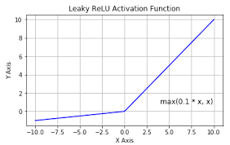
Leaky ReLu ACTIVATION FUNCTION
It is an attempt to solve the dying ReLu problem.
The leak helps to increase the range of the ReLu function. Usually, the value of a is 0.01 or so.

Slide 12
Pros and Cons of Leaky ReLu Activation function
Pros
There will be no problem with Dead ReLu.
A parameter-based method, Parametric ReLu : f(x) = max(alpha x,x), which alpha can be learned from back propagation.
Cons
1. It has not been fully proved that Leaky ReLu is always better than ReLu.

Slide 13
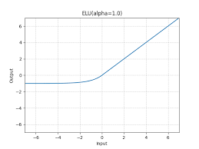
ELU FUNCTION
ELU is very similar to ReLu except negative inputs. They are both in identity function form for non-negative inputs. On the other hand, ELU becomes smooth slowly until its output equal to –(alpha) whereas ReLu sharply smoothes.

Slide 14
Pros and Cons of ELU Activation function
Pros
ELU becomes smooth slowly until its output equal to –(alpha) whereas ReLu sharply smoothes.
ELU is a strong alternative to ReLu.
Unlike to ReLu, ELU can produce negative outputs.
Cons
1. For x > 0, it can blow up the activation with the output range of [0, inf].

Slide 15
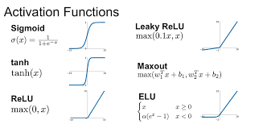

Slide 16
Thank You

